Slide 1
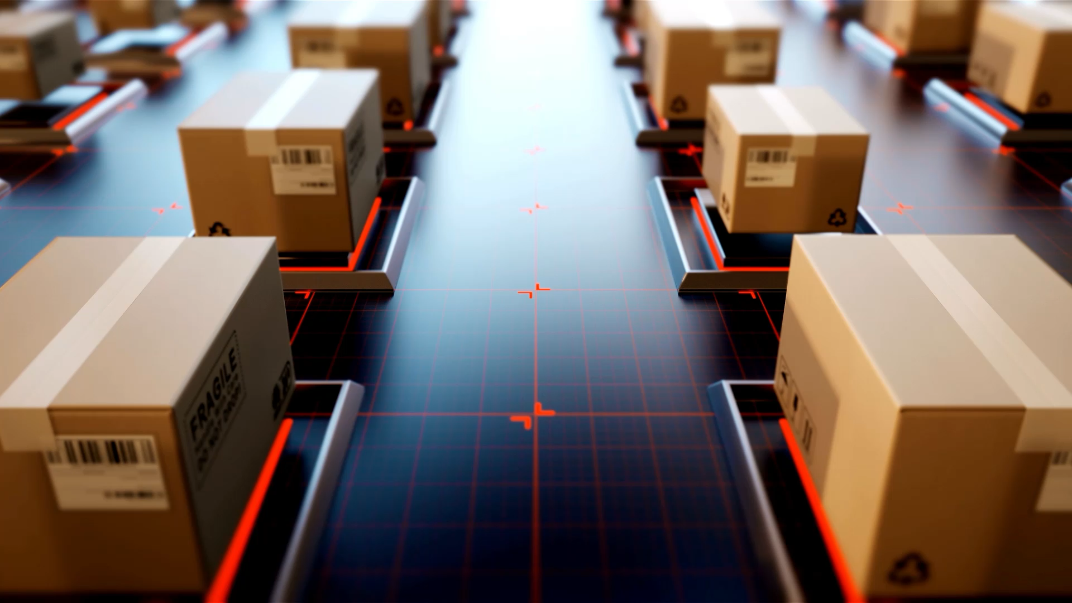
AI Assisted Navigation Device Module Integration
By Ritika Maikap & Ratnesh Kumar Tiwary

Slide 2

Big Picture
The application will have a front end in react.js. Along with all other features, the main feature lies in 2 buttons, ‘vision assist’ and ‘scan text’. Both these options will trigger separate python files having separate ML models, one for object detection another for text to speech conversion. Integration is the part where we compile several files into one unit so that every unit can interact with each other. We have integrated all the modules using FASTAPI and DOCKER.

Slide 3
Framework Flow
How the framework flows
React (frontend) shows two buttons:
“Vision Assist (Gradio)” → calls FastAPI /gradio/start.
FastAPI spawns gradio_app/live_gradio.py.
The script runs a Gradio UI (webcam in the browser) at http://127.0.0.1:7860.
React iframes(embed another webpage inside the current webpage) that URL.
“Scan Text” → calls FastAPI /ocr/start.
FastAPI spawns ocr_app/live_ocr_tts.py.
This opens a native OpenCV window on your Mac (not inside the page) and speaks via TTS(text to speech engine).
Key fact: a single webcam can’t be opened by two processes at once. So the reliable pattern is: run only one of your Python apps at a time on the same port (e.g., 7860). When you switch, cleanly stop the current process, start the other on the same port, and keep the iframe src unchanged (http://127.0.0.1:7860). The iframe will simply reload to the new app.

Slide 4
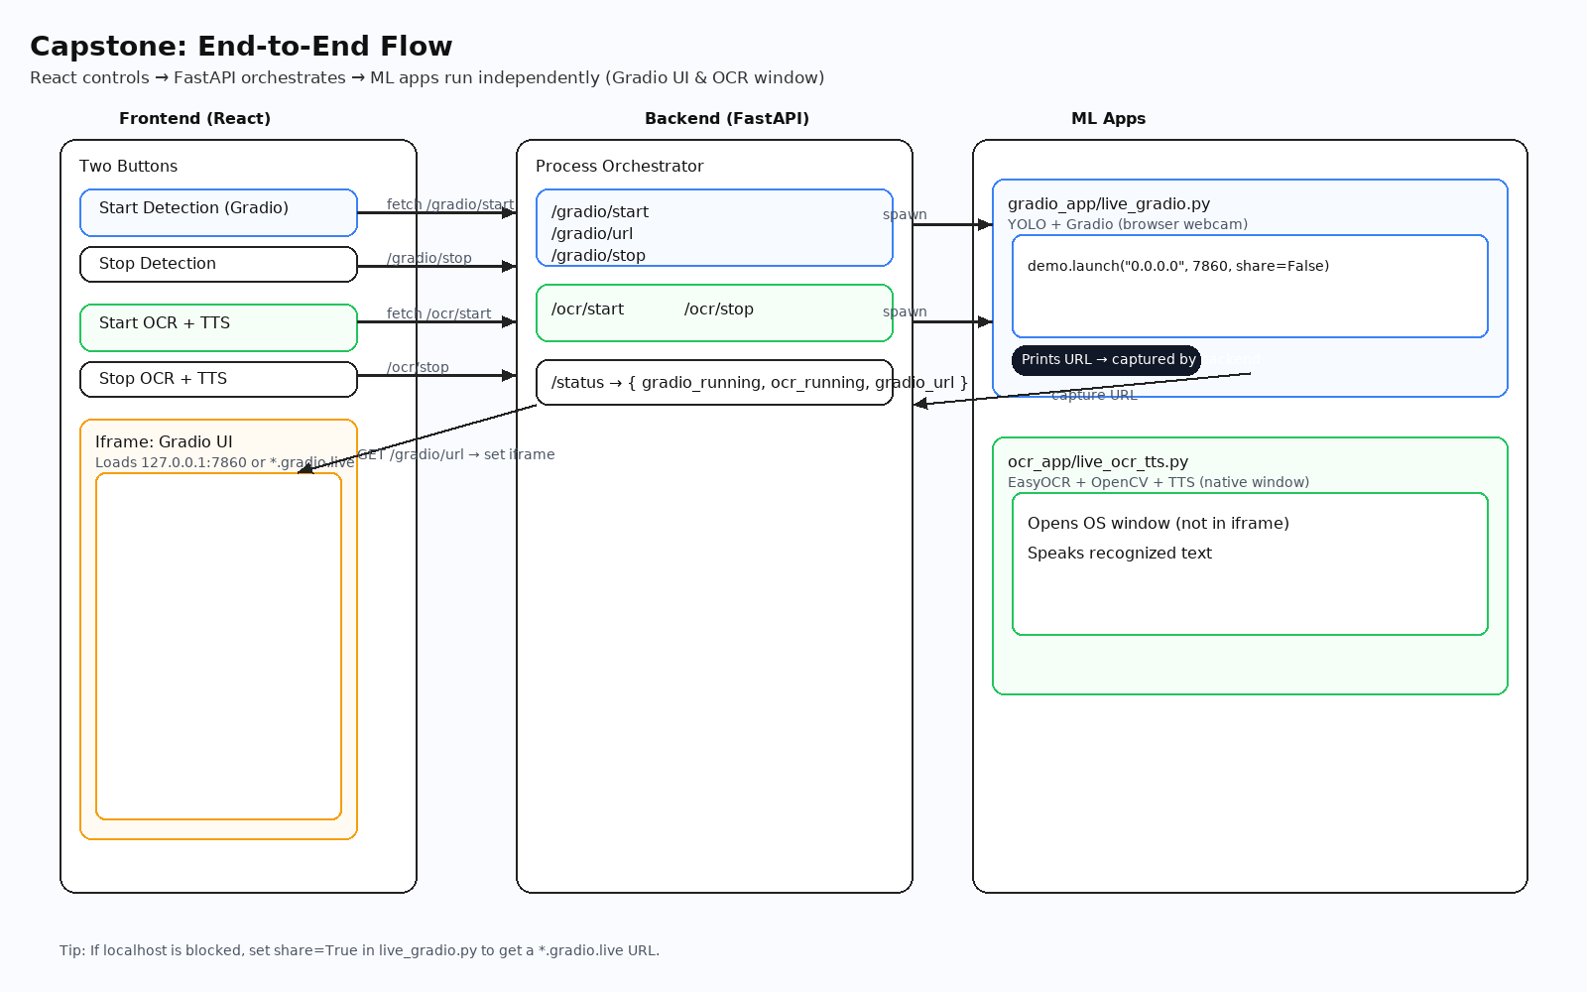

Slide 5

Dockerization
Docker makes your messy, version-sensitive stack run the same way everywhere—and it’s extra valuable for your project because you’ve got Node + FastAPI + Ultralytics/Torch + OpenCV/EasyOCR, which is a dependency minefield.
Here’s why it matters here:
Reproducibility: lock Python/Node versions, Torch/Ultralytics pins, OS libs. No more “works on my machine” or pip conflicts like you just hit.
One command up: docker compose up builds and runs frontend and backend consistently (ports, env vars, networks).
Clean isolation: ML deps (Torch, OpenCV, EasyOCR) live in the backend image; Node tooling lives in the frontend image—no cross-pollution with your host.
Easy onboarding & CI/CD: teammates and CI runners pull the exact images, run tests, and deploy the same artefacts you ran locally.
Deployment ready: ship the images to ECS/Kubernetes/VMs with identical behavior; no host-level fiddling.
Security & stability: container boundaries, predictable runtime, controlled permissions/ports.
Port & network wiring: Compose gives you a private network (frontend → backend), plus clean host mappings (5173, 8000, 7860).

Slide 6
Docker
Works with camera
Docker compose up
React.js UI
Object detection
Text to Speech
live_gradio.py
live_ocr_tts.py

Slide 7
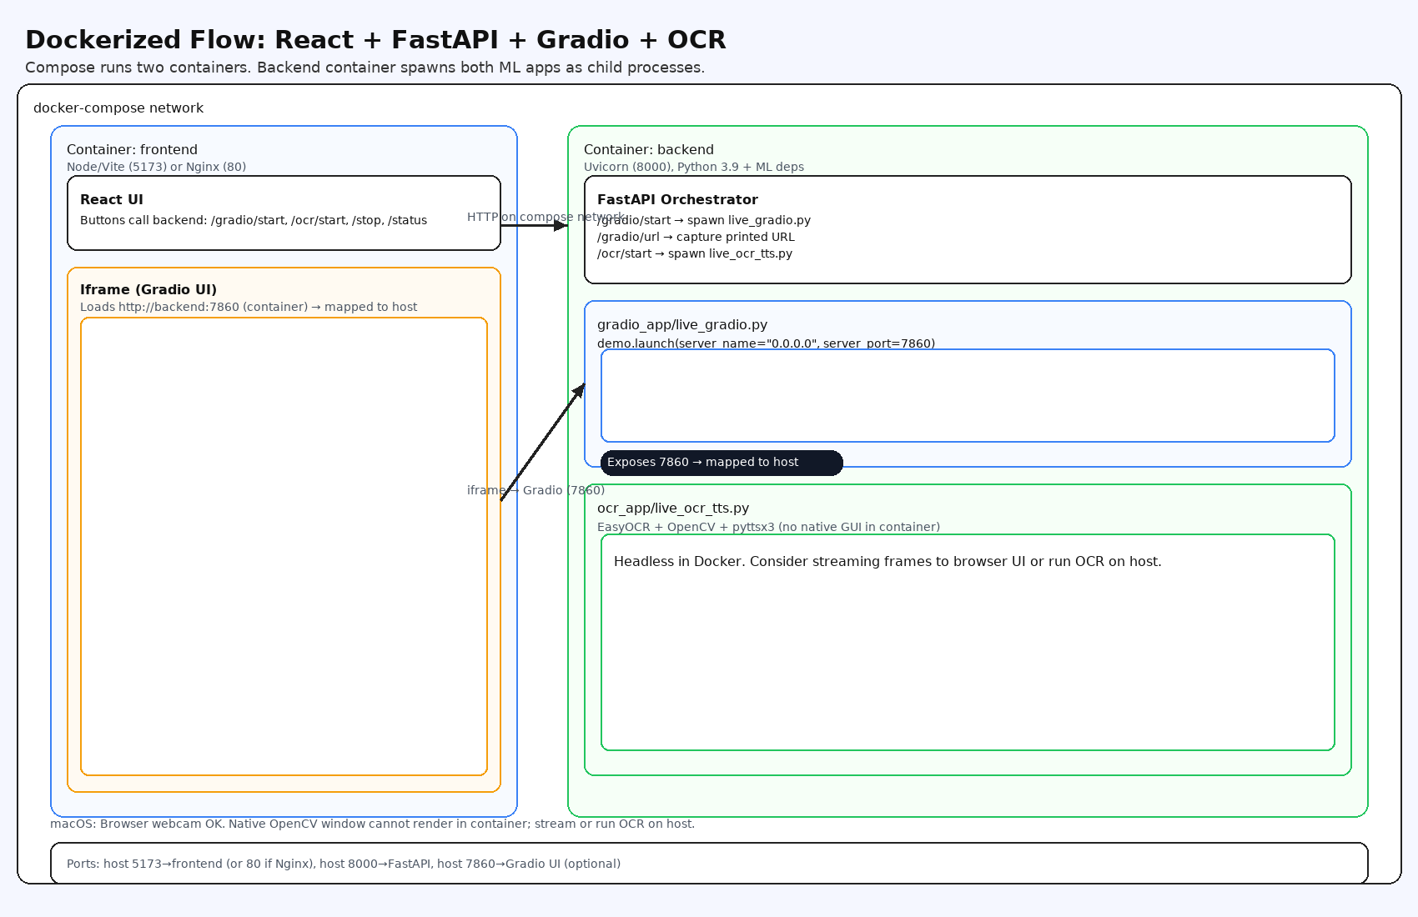

Slide 8
Thank you !

